Slide 1
Capstone 1:
20 years of US-Canada and US-Mexico
Border Traffic: Trends for future investment
Sam Holmstrom

Slide 2
Lots of traffic to US from both borders!
2000-2019
Total
Number
Of crossing
incidents
Total people
over 20
years
(27%)
227910 (77%)
(73%)
68273 (23%)
*More persons entered from Mexico
*More traffic from Canada

Slide 3
Total entries per transport mode of over 20 years
>>
=
<<

Slide 4
Have things changed over 20 years and how?
Goals: Identify changes in entry patterns into US in order to consider new investment strategies in specific transportation industries
Hypotheses: There have been changes in modes of traffic from both borders from 2000 to 2019. i.e. null hypothesis states that all patterns of
Border traffic are the same for 2000 and 2019 from Canada and Mexico
Method: Use a dataset from the US Bureau of Transportation to evaluate
trends
Dataset and information:
1. US-Canada or US-Mexico
2. Date of crossing the border
3. Mode of transportation
4. Counts of people crossing
https://www.kaggle.com/divyansh22/us-border-crossing-data

Slide 5
Overview of border crossing modes from Canada and Mexico
* = p < 0.005
Canada
Canada
*
‘00
‘01
‘02
‘03
‘04
‘05
‘06
‘07
‘08
‘09
‘10
‘12
‘13
‘14
‘15
‘16
‘17
‘18
‘19
Mexico
*
Mexico
‘00
‘01
‘02
‘03
‘04
‘05
‘06
‘07
‘08
‘09
‘10
‘12
‘13
‘14
‘15
‘16
‘17
‘18
‘19

Slide 6
Car entries have decreased
*
Canada
*
Mexico

Slide 7
……and steadily
Canada
Train passenger crossing
‘00
‘01
‘02
‘03
‘04
‘05
‘06
‘07
‘08
‘09
‘10
‘12
‘13
‘14
‘15
‘16
‘17
‘18
‘19
Mexico
‘00
‘01
‘02
‘03
‘04
‘05
‘06
‘07
‘08
‘09
‘10
‘12
‘13
‘14
‘15
‘16
‘17
‘18
‘19

Slide 8
Entries by trains have shown significant from 2000 to 2019!
* = p < 0.005
*
*
Canada
*
*
p=2.98e-20
*
Mexico
* = p < 0.005

Slide 9
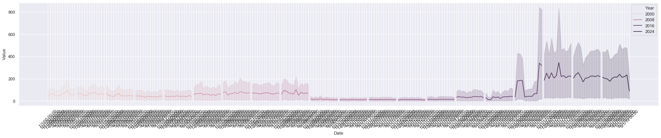
….and fairly suddenly and more recently!
Canada
Possible
growth
Industry
‘00
‘01
‘02
‘03
‘04
‘05
‘06
‘07
‘08
‘09
‘10
‘12
‘13
‘14
‘15
‘16
‘17
‘18
‘19
Mexico
‘00
‘01
‘02
‘03
‘04
‘05
‘06
‘07
‘08
‘09
‘10
‘12
‘13
‘14
‘15
‘16
‘17
‘18
‘19

Slide 10
Bootstrapping for confidence interval evaluation
Mexico train entry
Distributions
Produced normal distribution by central limit theorem for
2000
2019
p avlue
2000
2019
2.17280215e-227
95% confidence interval (two-tail) is between means 140 and 146

Slide 11
Conclusions and future directions
The train industry has shown a sudden and large growth in both countries
Car traffic is slowly decreasing
Perhaps interest in environment has lowered car travel
Look at specific port traffic to find other opportunities that might come to light from trends over time
Trains may be becoming a more efficient and growing industry for
Future investments

Slide 12
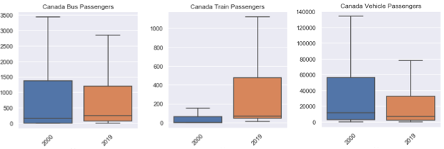
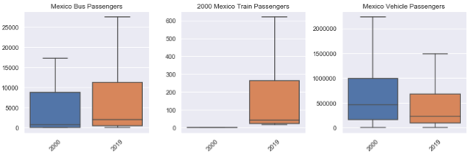
Trains industry has shown significant growth from 2000 to 2019!
* = p < 0.005
Buses
Trains
Cars
Canada
2000
2019
2000
2019
2000
2019
Mexico
2000
2019
2000
2019
2000
2019

Slide 13
Buses
Trains
Cars
2000
2019
2000
2019
2000
2019
2000
2019
2000
2019
2000
2019
2000
2019
2000
2019

